Slide 1
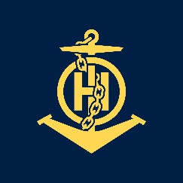
Mr
IHO – NIPPON FOUNDATION
ALUMNI SEMINAR
Muhammad Akbar Bin Paimin

Slide 2
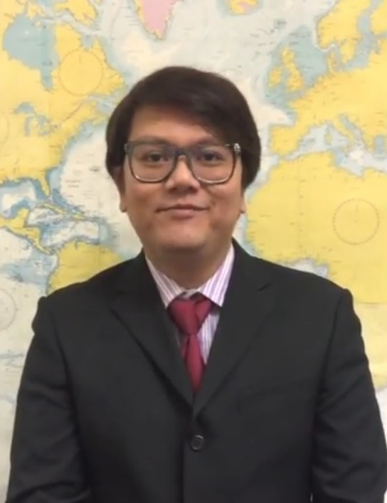
Self introduction
IHO – NIPPON FOUNDATION
ALUMNI SEMINAR
Name | MUHAMMAD AKBAR BIN PAIMIN
Alumni year | 2017 (JANUARY TO APRIL RUN)
Country | SINGAPORE
Organization | MARITIME AND PORT AUTHORITY OF SINGAPORE
Position/Job title | TECHNICAL EXECUTIVE
Current job description | PAPER CHARTS AND ENC COMPILATION AND ASSESSMENT, CAT ‘C’ BASIC CARTOGRAPHY COURSE FOR CARTOGRAPHERS TRAINER, LANDMARK SURVEYOR
Please put your photo here!

Slide 3
My career path and projects / Achievements
IHO – NIPPON FOUNDATION
ALUMNI SEMINAR
Cartographer - Compiler/Checker for both Paper Charts and ENCs
Trainer – Cat ‘C’ Basic Cartography Course For Cartographers
Landmark Surveyor

Slide 4
Lessons learned from CHART Course
IHO – NIPPON FOUNDATION
ALUMNI SEMINAR
Fully understand the basics of building up an ENC Cell, Databases and Paper Charts
Different Hydrographic offices will have different practices
Utilised all the publications that are available while doing production of ENC, Charts or databases, i.e. Sailing Directions, Lists of Lights, etc
Chart Scheming
Database to ENCs/Paper Charts Production

Slide 5
Suggestion for the future
IHO – NIPPON FOUNDATION
ALUMNI SEMINAR
Little exposure to the ECDIS machine during the training. Perhaps more hands-on on the ECDIS for future trainees could be helpful.

